Slide 1


ONLINE SHOPPERS INTENTIONS PREDICTION
Prashant kadam

Slide 2
Agenda
Introduction
Objective
Problem statement
Data Preprocessing flow
EDA
Data
Introduction
Modeling
Difficulties
Conclusion

Slide 3

Introduction
In today's rapidly evolving digital landscape, businesses strive to understand and predict customer behavior to enhance their online shopping experience and drive revenue growth. The ability to accurately analyze and predict customer purchasing behavior has become a key competitive advantage for online retailers. This has led to the emergence of machine learning techniques that leverage vast amounts of customer data to gain valuable insights and make data-driven decisions.
This project aims to explore and implement a machine learning solution to predict online customer purchasing behavior. By leveraging advanced algorithms and techniques, we can delve into the rich data generated by customers during their online shopping journey, such as browsing history, search queries, demographics, and past purchase patterns. By harnessing the power of machine learning, we can unlock hidden patterns and trends within this data, ultimately enabling businesses to make more informed decisions and enhance their overall customer experience.
3

Slide 4

OBJECTIVE & GOAL
The primary goal of this project is to build a predictive model that can accurately forecast customer behavior, such as the likelihood of making a purchase, the products or services they are likely to be interested in, and the factors that influence their decision-making process. By identifying these insights, businesses can tailor their marketing strategies, personalize product recommendations, optimize pricing strategies, and provide a seamless and engaging online shopping experience for their customers.
Goal
20%
Conversion Rate
OUR GOAL :-
● Giving insights and action recommendation to increase conversion rate
● Build a machine learning model to automatically predict which visitor will purchase
● Analyze Visitors behavior for better understanding
Now
15%
Conversion Rate

Slide 5

PROBLEM STATEMENT
"Predicting Online Customer Purchasing Behavior: Enhancing Customer Retention and Conversion Rates"
ANNUAL REVENUE GROWTH
Out of all visitors only 15% converted and make purchase. Based on the most updated reference, average ecommerce conversion/purchase rate is between 2-5%.
On 2023, consumers who shop online increase up to 88%*. 15% of Purchase Rate is too small.
Online Shoppers Intention

Slide 6
DATASET INFORMETION
The dataset was obtained from Kaggle (www.Kaggle.com/onlineshoppersintention)
There are 12330 rows and 18 column of online shopper customers sessions data in a one-year period.
Features Description:-
Administrative: This is the number of pages of this type (administrative) that the user visited.
Administrative_Duration: This is the amount of time spent in this category of pages.
Informational: This is the number of pages of this type (informational) that the user visited.
Informational_Duration: This is the amount of time spent in this category of pages.
ProductRelated: This is the number of pages of this type (product related) that the user visited.
ProductRelated_Duration: This is the amount of time spent in this category of pages.
BounceRates: The percentage of visitors who enter the website through that page and exit without triggering any additional tasks.
ExitRates: The percentage of pageviews on the website that end at that specific page.
PageValues: The average value of the page averaged over the value of the target page and/or the completion of an eCommerce transaction.
6

Slide 7
DATA DIFFICULTIES
The numerical features are highly skewed.
The prediction classes are Imbalanced with 15% TRUE & 85% FALSE classes
Many of these features do not contribute to prediction.
7

Slide 8
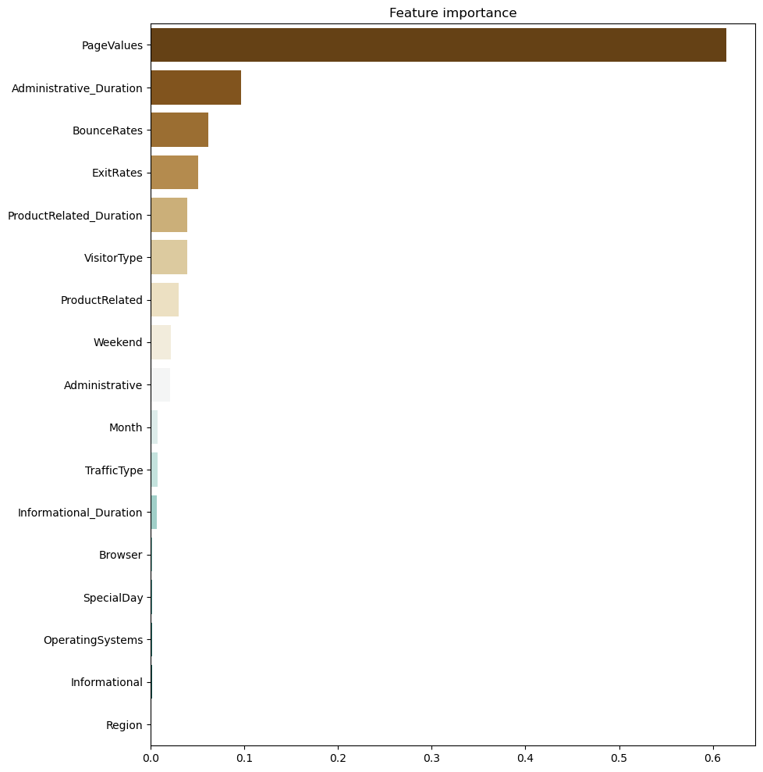
Most Important Features
EXPLORATORILY DATA ANALYSIS
8
Online Shoppers Intentions

Slide 9
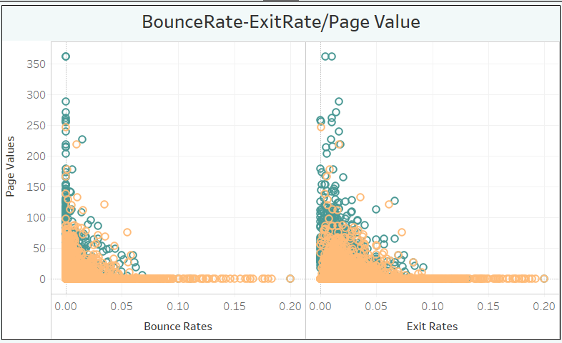
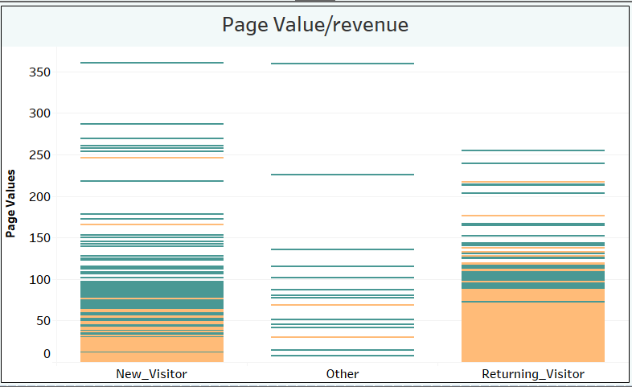
PAGE VALUE
Visitors with higher page values and higher product related duration tend to make a purchase.
9

Slide 10
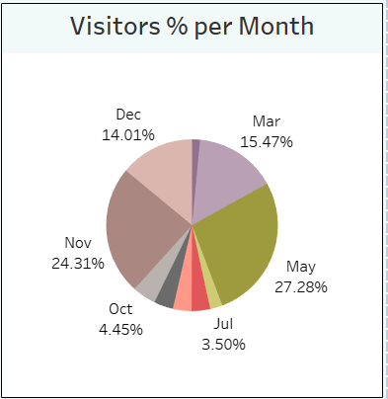
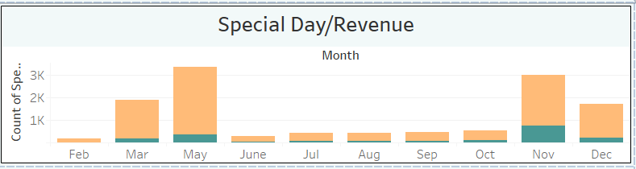
VISITORS
The highest amount of web traffic is at March - June but the conversion rate is lower compared to October - December. There is a potential to increase the conversion rate at March - June.
10

Slide 11
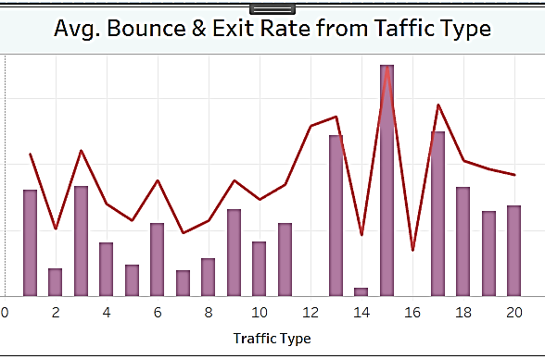
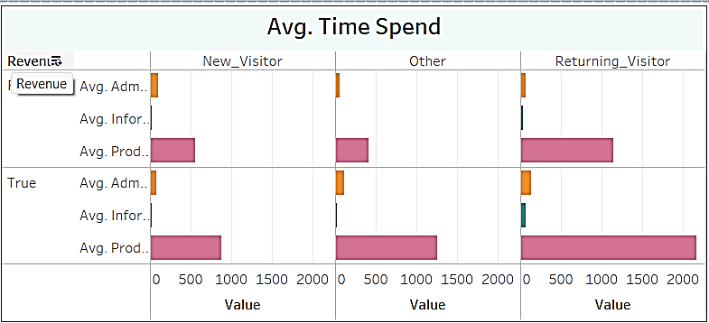
EXIT RATE & BOUNCE RATE
people who spend more time on product related pages tend to make a purchase.
11

Slide 12





Data Preprocessing
Missing Value
Handling Outliers
Numeric Feature Scaling
Categorical Feature Encoding
Handling Class Imbalance
There is no missing value in the dataset so nothing to handle
There are numerical features that indicates outliers, handled using Log Transformer Numeric
Standard Scaler
Hot-Encoader
SMOTE
12

Slide 13
MODELLING & EVALUATION
Model | Accuracy |  | Precision |  | Recall
 | Train | Test | Train | Test | Train | Test
Random Forest | 90% | 90% | 84% | 81% | 43% | 41%
Random Forest with SMOTE | 90% | 87% | 89% | 55% | 91% | 81%
Gradient Boosting | 91% | 87% | 76% | 79% | 60% | 21%
Gradient Boosting with SMOTE | 90% | 88% | 89% | 56% | 91% | 82%
The primary metric is Recall but Precision & Accuracy is also important.
Random Forest & Gradient boosting both models do best with SMOTE technique than other models.. After experimenting with hyperparameter tuning and cross validation, the model performance did not improve and they overfitted so we use the model before hyperparameter tuning with parameter max_depth = 3 & 5
13

Slide 14
Business Recommendation
Product Related Duration
Monthly Traffic
Improvements in terms of interface, ease of access, clarity of information, and product demonstration on Related Products.
Give some vouchers and holding an event in months who fall back
Page value
Page value can be increased by increasing traffic count quality. Page value can be optimized with Search Engine Optimization (SEO) or giving voucher per category product.
Exit Rate
Bounce Rate
Optimize pages with a high exit rate. Add Exit Intent Popups, CTA in the right place, and provide a live chat feature.
Make sure Customer should land on high value pages.
14

Slide 15

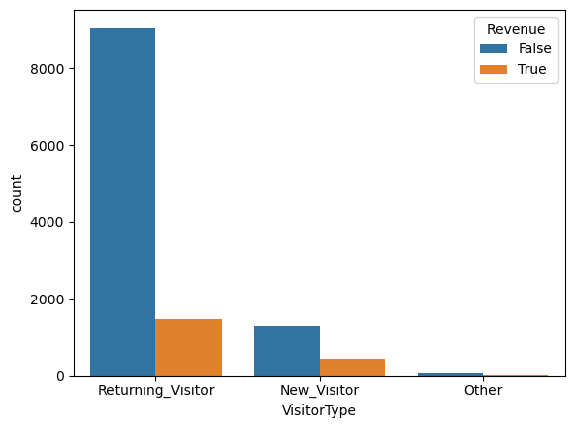
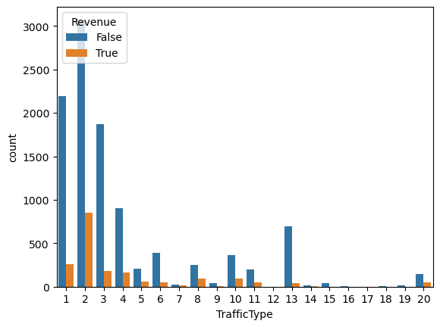
Areas of focus
Returning Visitors
Direct Traffic
Returning visitors are more than new visitors, but the percentage of revenue of returning visitors is smaller than that of new visitors.
Exit rate & Bounce rate from Direct Trafic is very less but Conversion rate is not good
15

Slide 16



How we get there
Returning Visitors Revenue
Discounts for newcomers and connections of loyal customers Visualize quality intellectual capital
Personalized email retargeting
Exit Rate & Bounce Rate
Exit rate strategy with personalized pop-ups
Smooth technical operations and user-friendly UI
Optimization of landing pages
Direct Traffic Count
Seasonal promotions and discounts
SEO optimization and Ads via Social Media
Weekend/Time based promotions and discounts
16

Slide 17

Summary
“The online customer purchasing behavior ML project successfully analyzed customer data using various machine learning techniques. By understanding customer preferences, identifying key trends, and implementing personalized marketing strategies, businesses can enhance customer satisfaction, increase sales, and improve overall performance. Continued monitoring and adaptation of ML models will be crucial for ongoing success in this domain.”
17

Slide 18




Thank you
Prashant Kadam
Prashantkadam1998@gmail.com

